Slide 1
LAYERED ARCHITECTURE: OSI LAYER AND TCP/IP Layers
CSC 223 Data Communication

Slide 2
Layered Architecture
Layer architecture simplifies the network design.
It is easy to debug network applications in a layered architecture network.
The network management is easier due to the layered architecture.
Network layers follow a set of rules, called protocol.
The protocol defines the format of the data being exchanged, and the control and timing for the handshake between layers.

Slide 3
Advantages of Layered Network Architecture
Provide modular approach for any network architecture
A new layer can be introduced any time (if required) without interfering other layers.
A layer can be removed easily if it‘s functions become obsolete.
Modification to a particular layer can be done without interfering other layers

Slide 4
Disadvantages of Layered Network Architecture
Increases the address overhead in data packet as it travels from bottom layer to the top layer

Slide 5
ISO/OSI Model
The International Standards Organization (ISO) Open Systems Interconnect (OSI) is a standard set of rules describing the transfer of data between each layer in a network operating system. Each layer has a specific function (i.e. the physical layer deals with the electrical and cable specifications)

Slide 6
OSI reference model
OSI (Open System Interconnection) is the most widely accepted model for understanding the network communication.
It was developed by ISO (International Standards Organization) in 1977
The purpose of OSI model is to open communication between different system without requiring changes to the logic of the underlying hardware and software

Slide 7
Its main objectives are to:
1. Allow manufactures of different systems to interconnect equipment through standard interfaces.
2. Allow software and hardware to integrate well and be portable on different systems

Slide 8
The principles of OSI model are as follows:
A layer should be formed where a different level of abstraction is required.
Each layer should execute a well-defined function.
The function of each layer should be chosen with an eye toward defining internationally standardized protocols.

Slide 9
The principles of OSI model are as follows:
The layer boundaries should be chosen to minimize the information flow across the interfaces.
The layers should be large enough that different functions need not be put together in the same layer out of requirement, and small enough that architecture does not become cumbersome.

Slide 10
The OSI model is now considered the primary Architectural model for inter-computer communications.
The OSI model describes how information or data makes its way from application programmes (such as spreadsheets) through a network medium (such as wire) to another application programme located on another network.
The OSI reference model divides the problem of moving information between computers over a network medium into SEVEN smaller and more manageable problems .
This separation into smaller more manageable functions is known as layering.

Slide 11
ISO/OSI Model
The OSI Model clearly defines the interfaces between each layer. This allows different network operating systems and protocols to work together by having each manufacturer adhere to the standard interfaces.
The application of the ISO OSI model has allowed the modern networks that exist today.
There OSI model has seven layers.

Slide 12
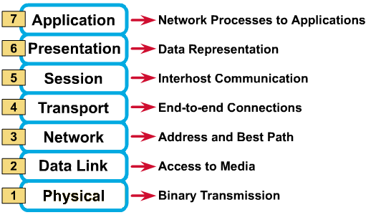

Slide 13
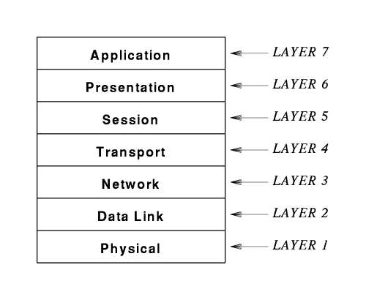
Seven layers in the OSI model.

Slide 14
The Interconnection Layers
Interconnection group of standards makes up the bottom 4 layers of the OSI model, which are known as the physical, data link, network and transport layers.
The physical layer defines the functional, procedural and physical interfaces of communication links between equipment.
For example, plug specifications, and pin allocations.

Slide 15
The data link layer adds error-checking information and formats data for physical transmission.
The network layer provides routing and multiplexing services.
The transport layer includes error detection and correction as well as multiplexing. Its basic function is to enhance the quality provided by the network layer below, if this is necessary

Slide 16
The Internetworking Layers
The internetworking group includes the top 3 layers of the OSI model and basically provides the support services for the user applications. They are known as the session, presentation, and application layers.
The session layer provides the organization, synchronization and timing of the exchange of the data between end systems.

Slide 17
The presentation layer is concerned with now the information to be exchanged. This includes resolving character set differences, such as ASCII to EBCDIC, providing text compression and encryption/decryption services
The application layer provides support for the user applications, which wish to exchange information. (i.e. file transfer)

Slide 18
The Physical Layer (Layer 1)
Physical layer is the bottom layer of the OSI Reference Model. The physical layer is responsible for transmission of the bit stream. It accepts frames of data from data link layer and transmits over a communication channel, one bit at a time
Establishes the physical characteristics of the network (e.g., the type of cable, connectors, length of cable, etc.)

Slide 19
The Physical Layer (Layer 1)
Defines the electrical characteristics of the signals used to transmit the data (e.g. signal voltage swing, duration of voltages, etc.)
Transmits the binary data (bits) as electrical or optical signals depending on the medium.

Slide 20
Data Link Layer (Layer 2)
The data link layer is responsible for reassembling any binary streams received from the physical layer back into frames. The data link layer is also responsible for detecting and correcting any errors.
Defines how the signal will be placed on or taken off the NIC. The data frames are broken down into individual bits that can be translated into electric signals and sent over the network. On the receiving side, the bits are reassembled into frames for processing by upper levels.

Slide 21
Data Link Layer (Layer 2)
Error detection and correction is also performed at the data link layer. If an acknowledgement is expected and not received, the frame will be resent. Corrupt data is also identified at the data link layer.
Because the Data-Link Layer is very complex, it is sometimes divided into sublayers (as defined by the IEEE 802 model). The lower sublayer provides network access. The upper sublayer is concerned with sending and receiving packets and error checking.

Slide 22
Network Layer (Layer 3)
This layer is responsible for establishing the route to be used between source and destination computers
Primarily concerned with addressing and routing.
Logical addresses (IP address) are translated into physical addresses (MAC address) for transmission at the network layer. On the receiving side, the translation process is reversed.

Slide 23
Network Layer (Layer 3)
It is at the network layer where the route from the source to destination computer is determined. Routes are determined based on packet addresses and network conditions.
Traffic control measures are also implemented at the network layer.

Slide 24
Transport Layer (Layer 4)
The basic function of the transport layer is to accept data from session layer and split up into smaller packets then pass to the network layer; ensure that all of them arrive correctly at the other end. The transport layer is responsible for end-to-end integrity of transmissions.
Performs error handling in that it ensures all data is received in the proper sequence and without errors. If there are errors, the data is retransmitted

Slide 25
Transport Layer (Layer 4)
On the sending side, messages are packaged for efficient transmission and assigned a tracking number so they can be reassembled in proper order.
On the receiving side, the packets are reassembled, checked for errors and acknowledged.

Slide 26
The Session Layer (Layer 5)
Is responsible for establishing, maintaining, and terminating a connection called a 'session'.
The function of session layer is to manage the flow of communications during a connection between two computer systems.
It determines whether communications can be unidirectional or bidirectional. It also ensures that one request is completed before a new one is accepted.

Slide 27
The Session Layer (Layer 5)
A session is an exchange of messages between computers (a dialog). Managing the session involves synchronization of user tasks and dialog control (e.g., who transmits and for how long).
Synchronization involves the use of checkpoints in the data stream. In the event of a failure, only the data from the last checkpoint has to be resent.
Logon, name recognition and security functions take place at the Session Layer.

Slide 28
The Presentation Layer (Layer 6)
The presentation layer handle the syntax and semantics of the information exchanged between two systems.
This layer is responsible for data translation, encryption, decryption and compression.
The redirector operates at the presentation layer by redirecting I/O operations across the network.

Slide 29
The Presentation Layer (Layer 6)
The Presentation Layer is primarily concerned with translation; interpreting and converting the data from various formats. For example, EBCIDIC characters might be converted into ASCII.
It is also where data is compressed for transmission and uncompressed on receipt. Encryption techniques are implemented at the Presentation Layer.

Slide 30
The Application Layer (Layer 7)
The application layer is the top layer of the OSI Reference Model. Application layer provides the interface between applications and network’s services.
Provides the operating system with direct access to network services.
It serves as the interface between the user and the network by providing services that directly support user applications.

Slide 31
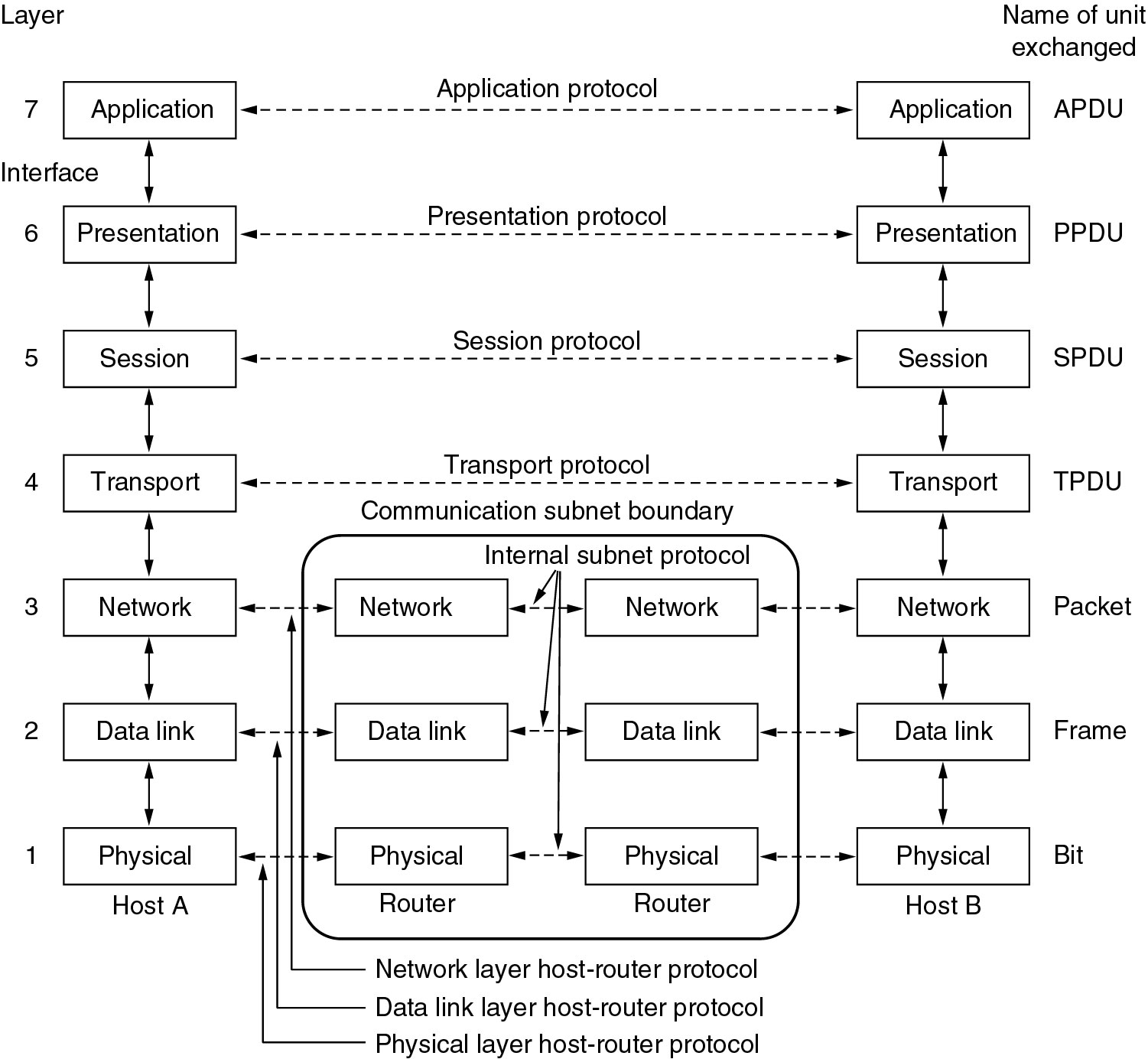
OSI Model

Slide 32
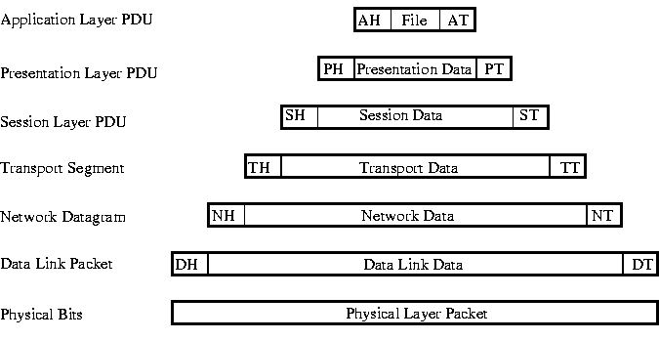
OSI Model
Each layer may add a Header and a Trailer to its Data (which consists of the next higher layer's Header, Trailer and Data as it moves through the layers). The Headers contain information that specifically addresses layer-to-layer communication. For example, the Transport Header (TH) contains information that only the Transport layer sees. All other layers below the Transport layer pass the Transport Header as part of their Data.

Slide 33
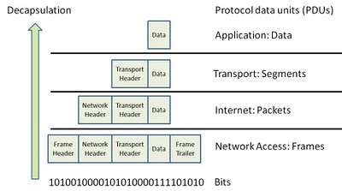
Bits/Frames/Packets/Segments

Slide 34
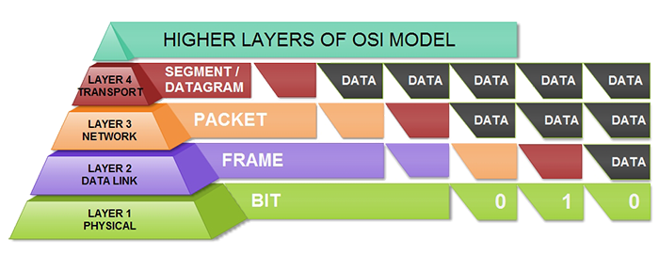

Slide 35
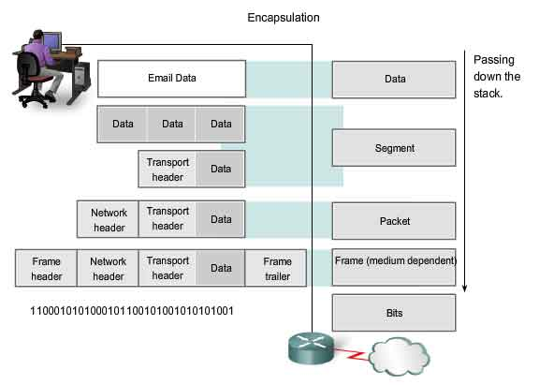

Slide 36
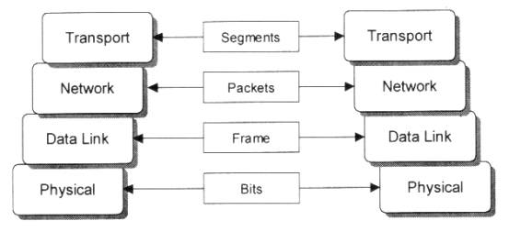

Slide 37
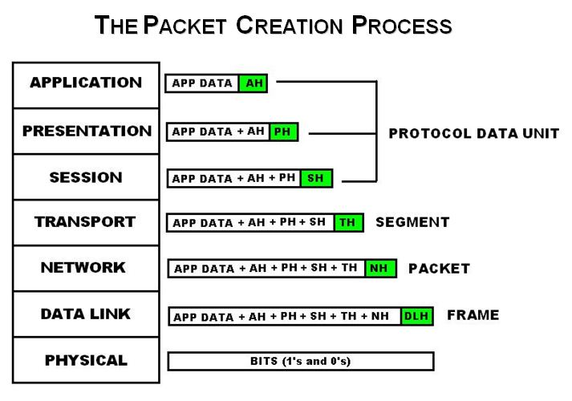

Slide 38
The TCP/IP Architecture
The TCP/IP architecture evolved out of experience with an earlier packet switched network ARPANET, sponsored by the DoD (US department of defense)

Slide 39
The TCP/IP Architecture
The TCP/IP model organizes the communication task into four independent layers
Application layer
Transport layer
Internet layer
Host-to-network layer

Slide 40
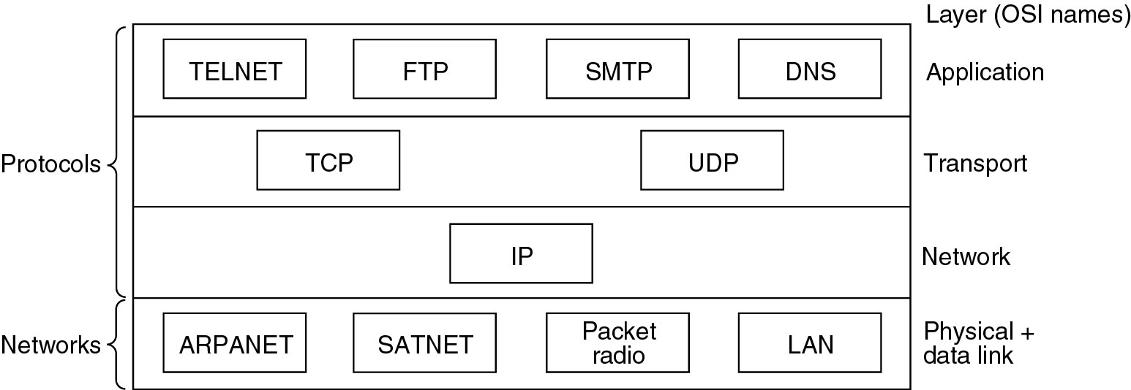
The TCP/IP Architecture

Slide 41
The Internet layer
This is the protocol that supports the interconnection of multiple network technologies into a single logical internetwork: Uses Packet switching based on a connectionless internetwork layer
This internet layer holds the whole architecture together. It allows packets to travel from one network to a potentially different destination network.
The function of the internet layer is to deliver IP packets to their destination. The internet layer defines an official packet format and protocol called IP.

Slide 42
The transport layer
The transport layer provides logical channels to allow application programs on source and destination machines to carry on a conversation
The TCP (transmission Control protocol) provides a reliable byte stream channel.
The UDP(User Datagram Protocol) provides an unreliable datagram Channel.

Slide 43
The application layer
Running above the transport layer are a range of application protocols.
Examples of TCP/IP application protocols
TELNET
FTP(File Transfer Protocol)
SMTP(Simple mail transfer protocol)
SNMP(Simple Network Management Protocol)
DNS(Domain Name System)
HTTP

Slide 44
The application layer
They enable interoperation of popular applications.
E.g. Either Netscape, Internet explorer, Mosaic can be used to access any web server (also different implementations) because they all conform to the same application layer protocol: HTTP.

Slide 45
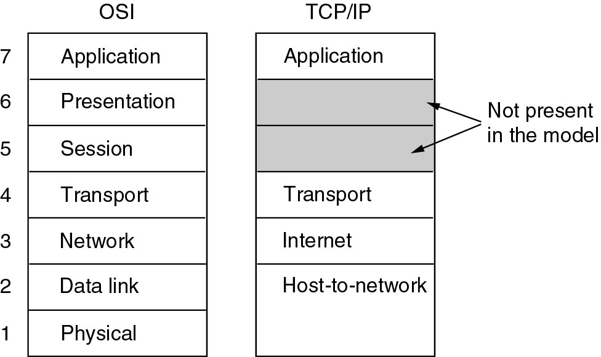
OSI Vs TCP/IP

Slide 46
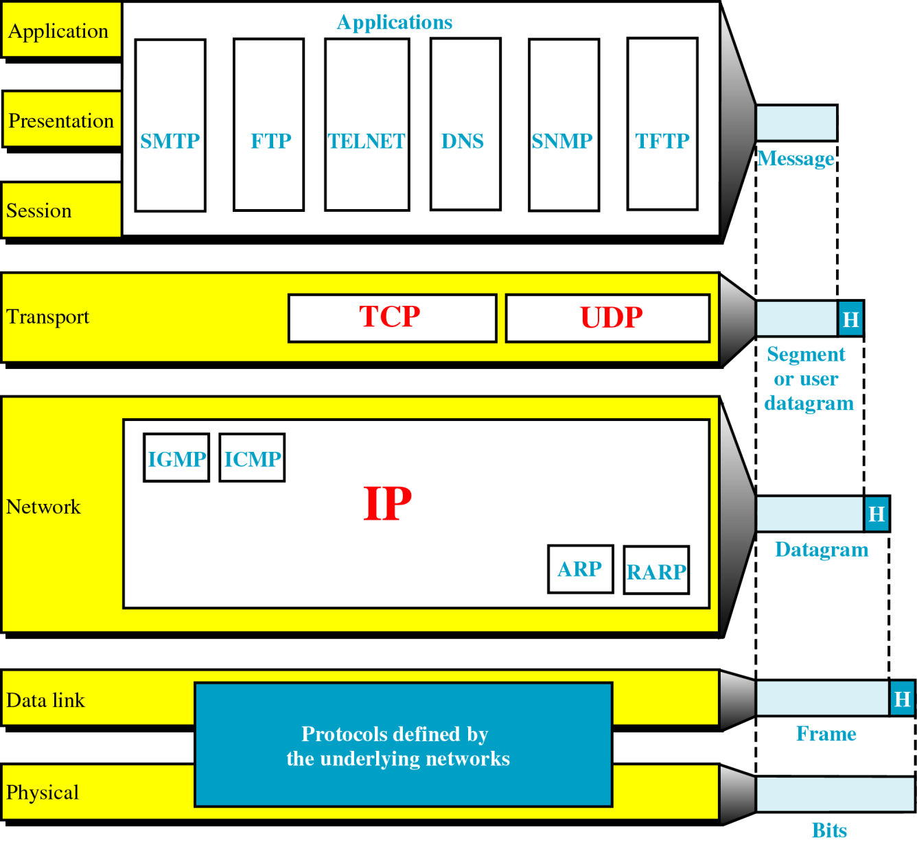
OSI vs. TCP/IP

